Slide 1
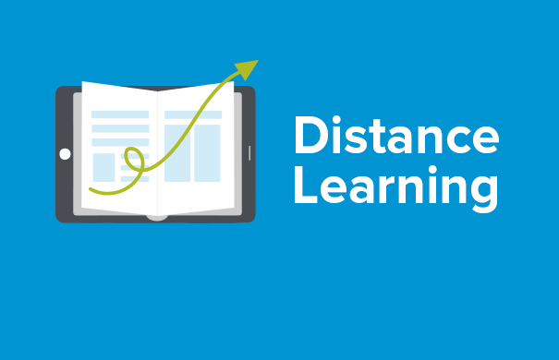
Dr. Arcega’s Distant Learning Procedures

Slide 2
Welcome to Distant Learning
How do I get started ?
Each student must log into their assigned Google account. After logging in your account, go to Google classroom. There are small boxes on the top right hand side of the website. Select the small boxes and select Classroom. Once you are in the application, search for your class. In your class there is a small folder icon on the bottom right corner. There will be weekly assignments in each folder. The assignments are in a module format. Follow the procedures in each module.

Slide 3
Attendance - Follow the school schedule regarding distance learning attendance. The instructor will follow the same schedule for attendance and office hours.

Slide 4
Proper Etiquette in Distance Learning - Be respectful whenever you communicate (email or Google Meet) with the instructor. Address the instructor as “Dr. Arcega” as the proper title for the instructor. - Do not use any profanity or any inappropriate language while you are communicating with the instructor.

Slide 5
Google Classroom/Meet There are tutor guides for Google Classroom and Google Meet in English and Spanish. It can help you through the process. See the other files in the folder regarding tutorials.

Slide 6
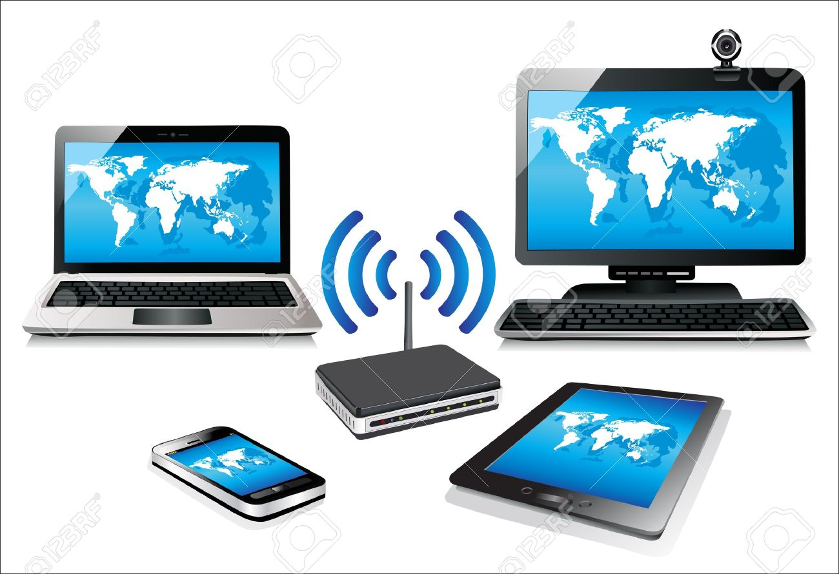
Materials & Equipment
Textbook (World History or Economics). If you do not have a textbook, you can use the Digital Textbook through Powerschool.
Computer or Laptop
Internet Connection

Slide 7
Assignments
The assignments will be done through the district assigned textbooks. If you do not have a textbook, you can use the Digital Textbook through Powerschool. Use the link below.
https://powerschool.avhsd.org/public/

Slide 8
If you have any questions, email me @ aarcega@avhsd.org I will be available during my office hours

